Slide 1
Big Data Frameworks
Ramesh Ragala
VIT Chennai

Slide 2
Hadoop I/O
Data Integrity:
No data will be lost or corrupt during storage or processing
Possibility of errors (I/O operation, data transferring in network)
How to Identify the corrupted Data:
Error Detection Mechanisms
Error Correction Mechanisms
Error Detection Mechanism:
Checksum
Checksum is computed for the data when it first enters the system and again whenever it is transmitted across a channel
The Common type of Checksum used in hadoop is CRC-32 (ChecksumFileSystem )[CRC-32C]
CRC-32C checksum is 4 bytes long → the storage overhead is less than 1%

Slide 3
Hadoop I/O
Datanodes are responsible for verifying the data they receive before storing the data and its checksum.
When clients read data from datanodes, they verify checksums as well, comparing them with the ones stored at the datanodes.
Each datanode keeps a persistent log of checksum verifications, so it knows the last time each of its block was verified.
When the client verifies a block, it tells the datanode, which updates its log. → helps to identify the bad disks
DataBlockScanner thread runs periodically at background.
Can we solve bad blocks through replica?????

Slide 4
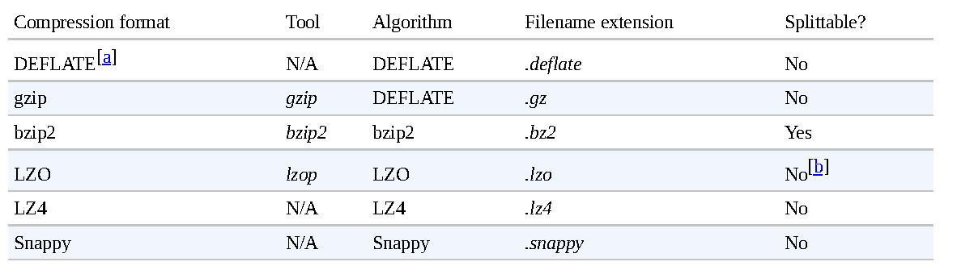
Hadoop I/O
Compression:
It reduces the space needed to store files
It speeds up data transfer across network or from disk
Faster compression and decompression speeds usually comes at the expense of smaller space savings

Slide 5
Hadoop I/O
Data Compressions
gzip has good performance in compression and space/time trade-off
bzip2 compress more effectively than gzip, but slower.
bzip2 has fast decompress
A codec is the implementation of a compression-decompression algorithm
CompressionCodec interface is used in hadoop
For performance, it is preferable to use a native library for compression and decompression

Slide 6
Hadoop I/O
USE CASE
How to compress data that will processed by MapReduce
Is the compression format supports splitting?
Assume Dataset size is 1GB
Assume HDFS block size is 128MB → 8 blocks
Imagine that the file is a gzip-compressed file whose compressed size is 1 GB
Creating a split for each block won’t work, because it is impossible to start reading at an arbitrary point in the gzip stream.
Impossible for a map task its split independently of the others.
The gzip format uses DEFLATE to store the compressed data and DEFLATE stores data as a series of compressed blocks.
The problem is that the start of each block is not distinguished in any way would allow a reader positioned at an arbitrary point → Synchronizing problem.
So gzip is not support for splitting
Mapreduce will not try to split the gzipped file → expensive of locality (single map will process 8 blocks and most of the blocks will not be local to the map)

Slide 7
Hadoop I/O
USE CASE
How to compress data that will processed by MapReduce
Assume the file is a LZO file. → same problem
The compression format does not provide a way for a reader to synchronize itself with the stream.
pre-processing LZO files using an indexer tool.
A bzip2 file supports

Slide 8
Hadoop I/O
Serialization:
Process of turning structured object into a byte stream for transmission over a network or for writing to persistent storage.
Process of turning a byte stream back into a series of structured objects → Deserialization.
For Inter-Process Communication : RPC is used in Hadoop for IPC
For persistent storage
The RPC uses Serialization → renders message into byte stream → sent to remote node → deserialization @ remote node
RPC Serialization Format should be:
Compact
Best use of network bandwidth
Fast
Little performance overhead
Extensible
Protocols change over time to meet new requirements
Interoperable
Different languages ( client & server)

Slide 9
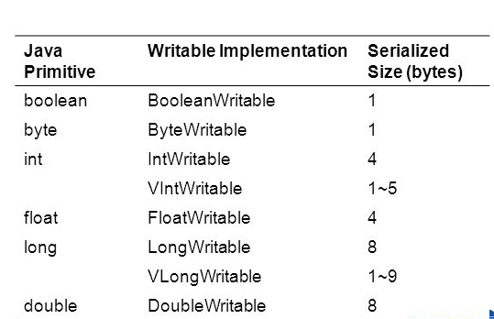
Hadoop I/O
The data format chosen for persistent storage would have different requirements from a serialization framework.
Writable Interface:
Writing its state to DataOutput binary stream
Void write(DataOutput)
Reading its state from a DataInput binary stream
Void readFields(DataInput in)

Slide 10


